Slide 1
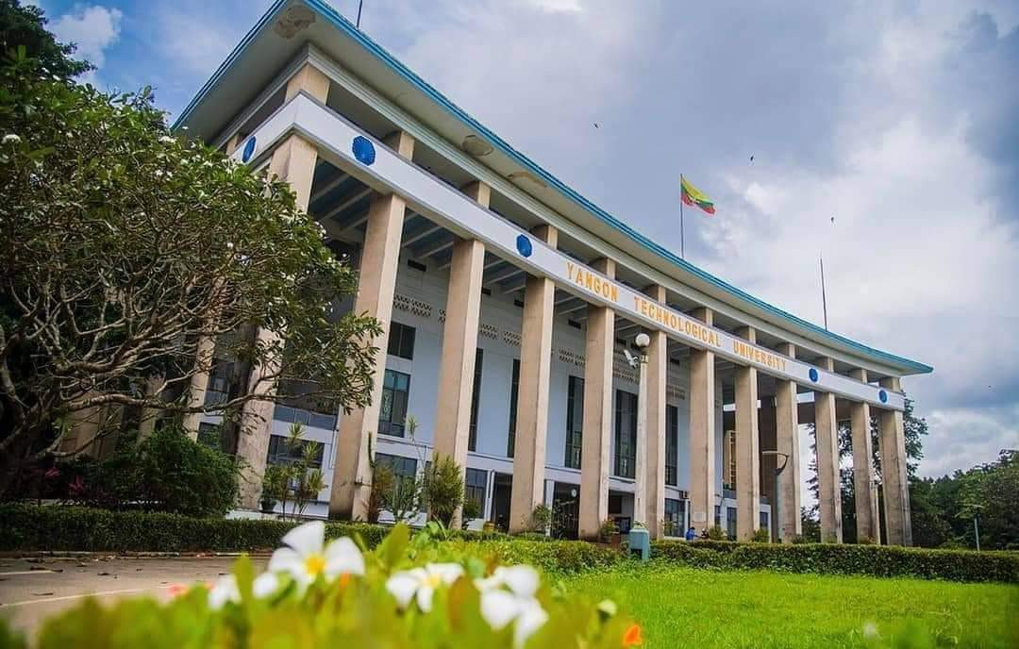
RIT-YIT-YTU
Rangoon Institute of Technology
Yangon Institute of Technology
Yangon Technological University
Presented by GROUP-4
Aung Zaw Oo
Nga Sai
Emerald

Slide 2
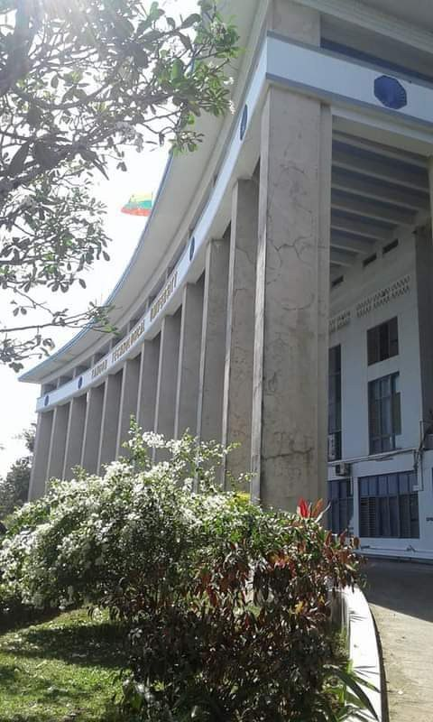
OUTLINES OF PRESENTATION
History
Memorial Places / Sense of the Places
Events of Revolution
YTU as a Political Heritage

Slide 3
HISTORY
Engineering academic began in the old Rangoon Days as it formed as Department of Engineering under Rangoon University in 1924.
In 1927, it became a separate entity, BOC College of Engineering and Mining.
In 1946, the college became the Faculty of Engineering of Rangoon University.
In 1961, the college became Burma Institute of Technology (BIT) of Rangoon University and was moved to the current building complex in Gyogone built by the Soviet Union.
In 1964, BIT was renamed Rangoon Institute of Technology (RIT)
The university was renamed Yangon Institute of Technology (YIT) in 1990 and was placed under the Ministry of Science and Technology in 1997. In 1998, the name of the university was changed to Yangon Technological University (YTU).
Ministry of Science and Technology was formed in 2nd Oct 1996 and formal engineering academic was break down into 3 phases ( Diploma Level , B.Tech and BE ) . There were 33 local Technological Universities were built up across the country and main campus was closed until 2016.

Slide 4
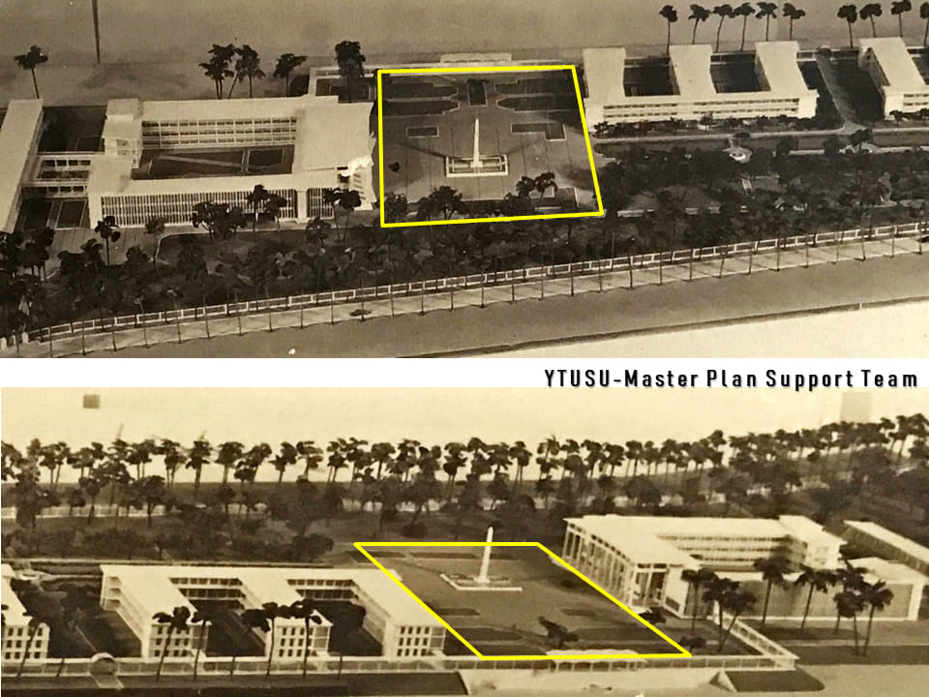
MEMORIAL PLACE /
SENSE OF THE PLACE
OVERVIEW OF RIT COMPLEX

Slide 5
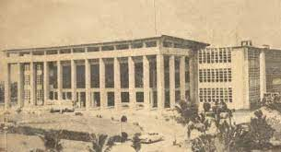
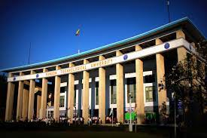
MEMORIAL PLACE / SENSE OF THE PLACE
MAIN BUILDING
Built in 1958
Architectural design by Soviet Architect Pavel Steniushin.

Slide 6
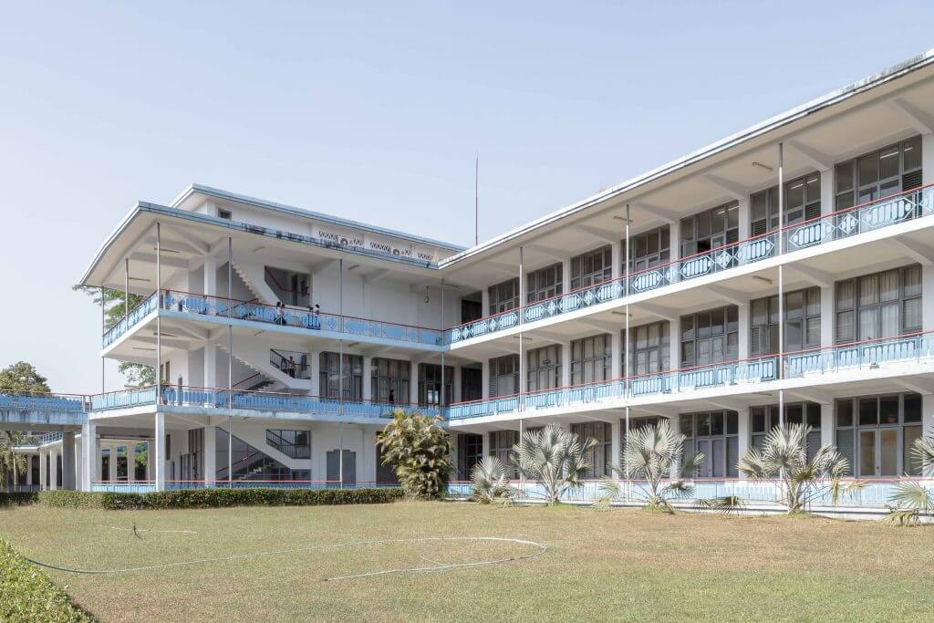
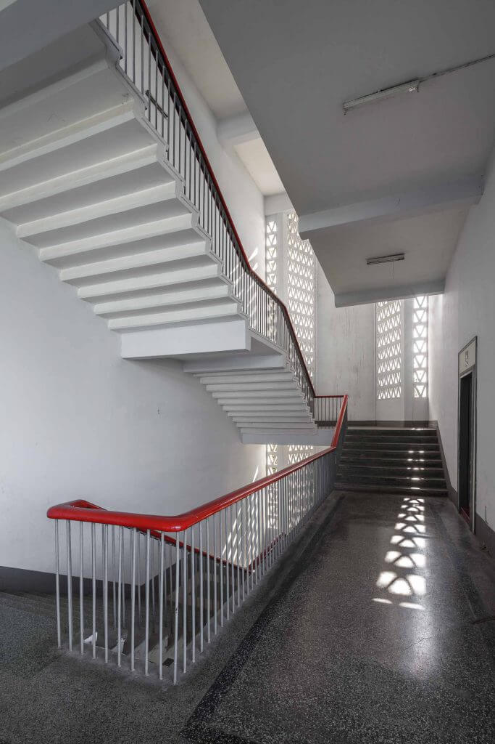
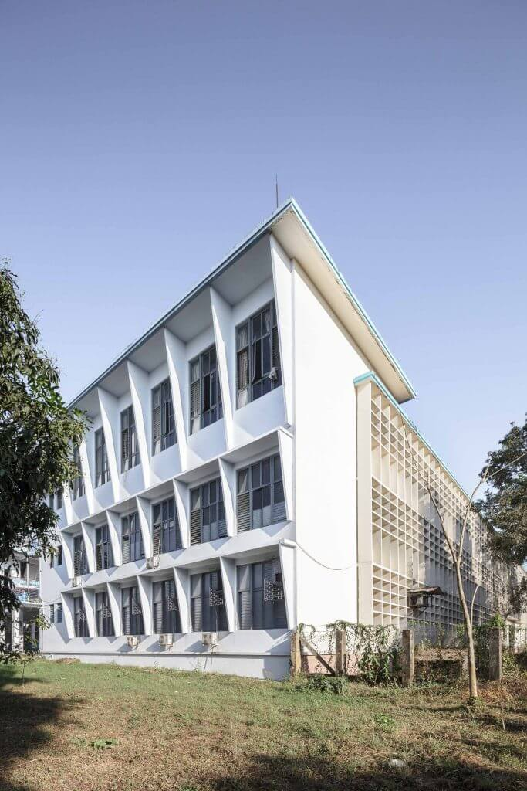
MEMORIAL PLACE / SENSE OF THE PLACE
MAIN BUILDING

Slide 7
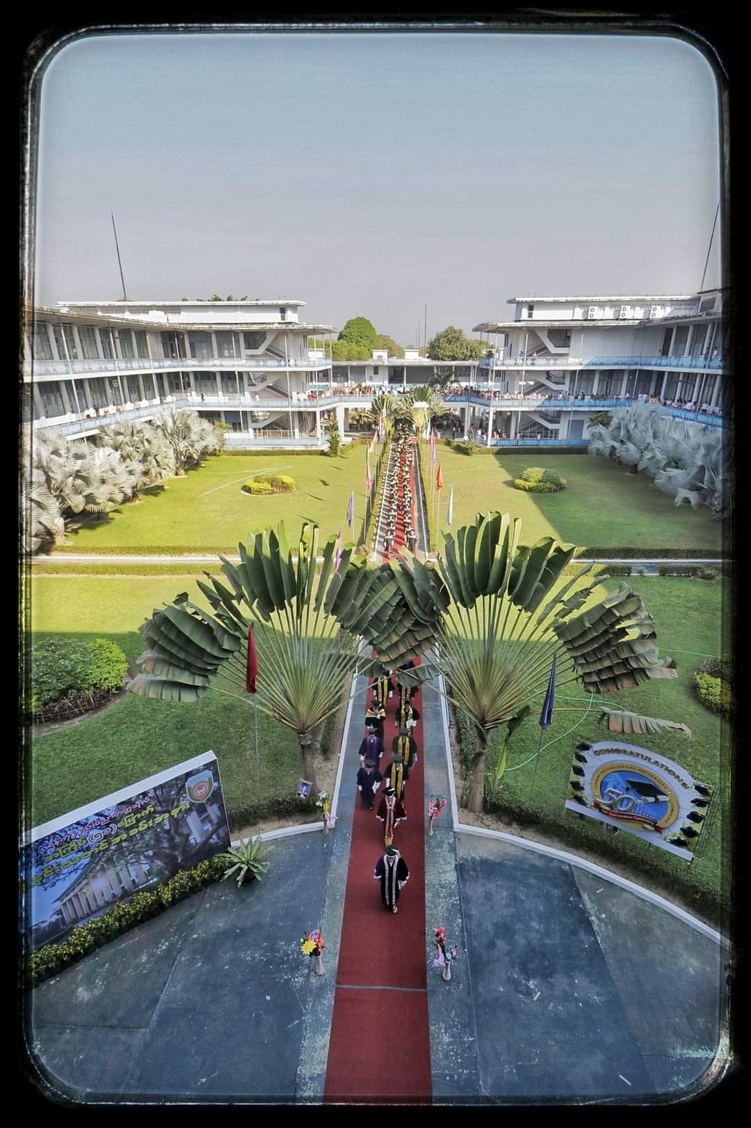
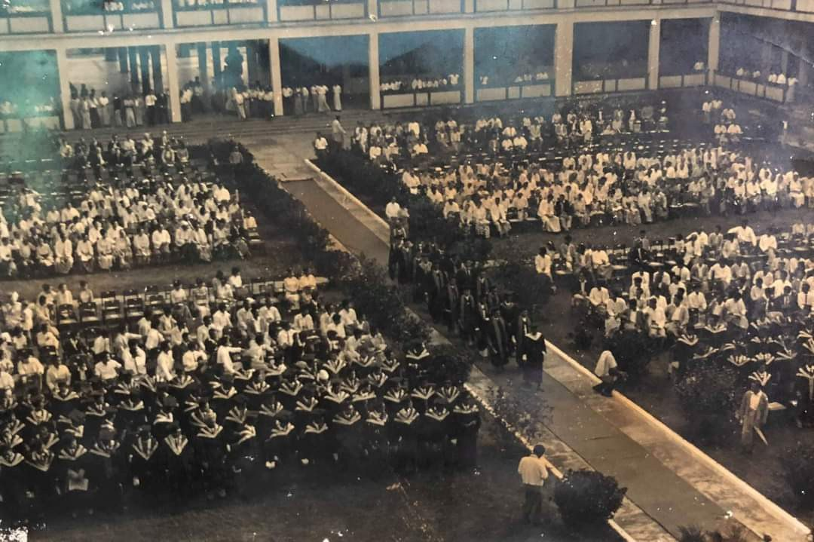
MEMORIAL PLACE / SENSE OF THE PLACE
AW BAR STREET (ဩဘာလမ်း)

Slide 8
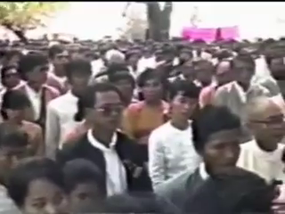
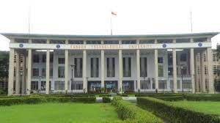
MEMORIAL PLACE / SENSE OF THE PLACE
UNIVERSITY’ SQUARE

Slide 9
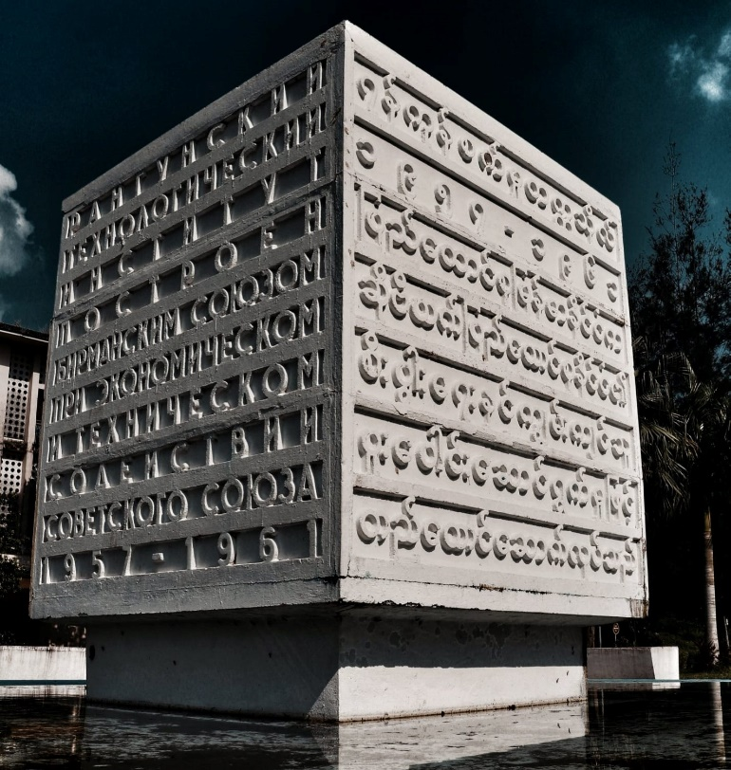
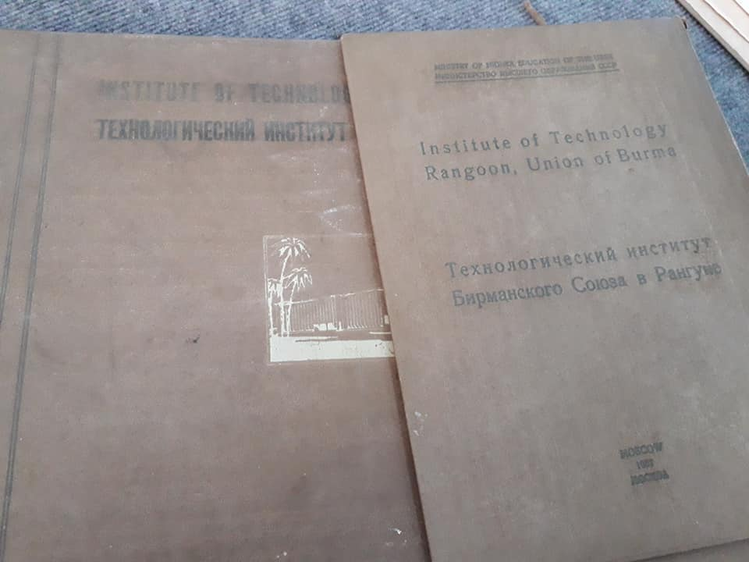
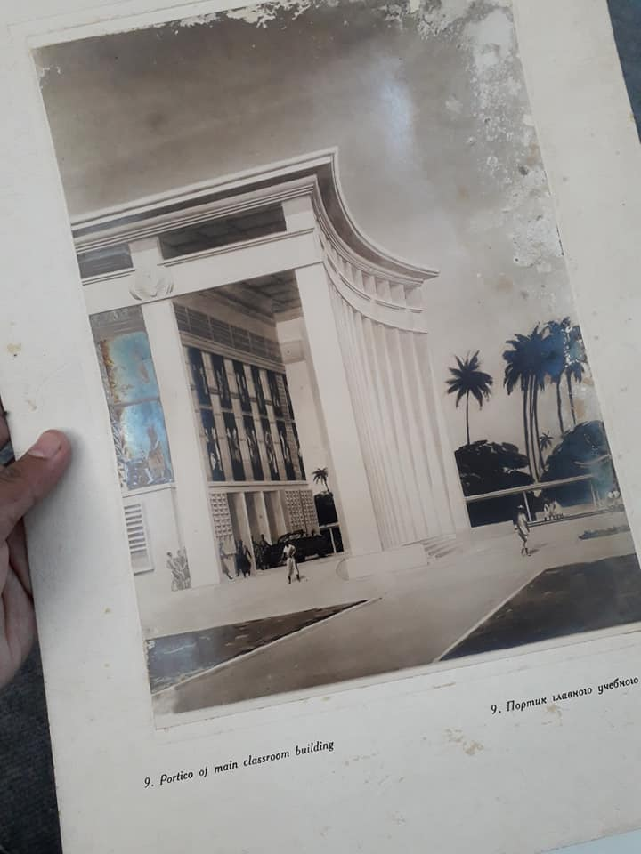
MEMORIAL PLACE / SENSE OF THE PLACE
YAGON URBAN HERITAGE
BY
YANGON HERITAGE TRUST

Slide 10
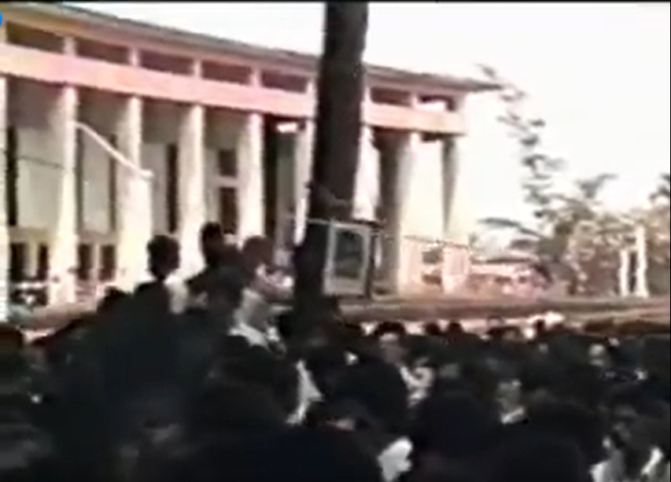
EVENTS OF REVOLUTION
8888 UPRISING
1988 March 13, Ko Phone Maw was shot dead in the complex .
After death of Ko Phone Maw , hundreds of students were arrested by the military and the university was closed.

Slide 11
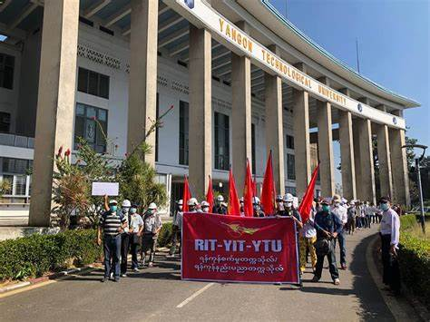
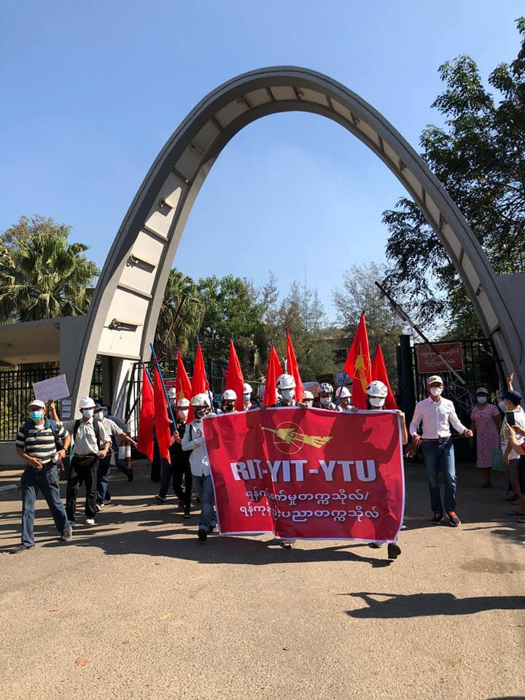
EVENTS OF REVOLUTION
SPRING REVOLUTION 2021

Slide 12
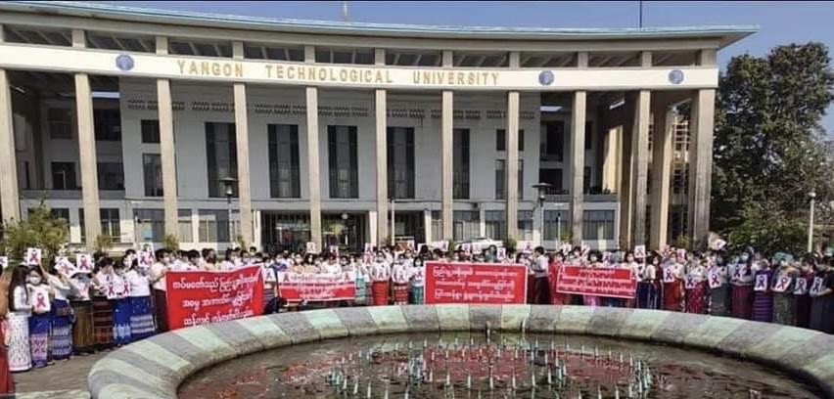
EVENTS OF REVOLUTION
SPRING REVOLUTION 2021
CIVIL DISOBEDIENCE MOVEMENT IN
SPRING REVOLUTION 2021

Slide 13
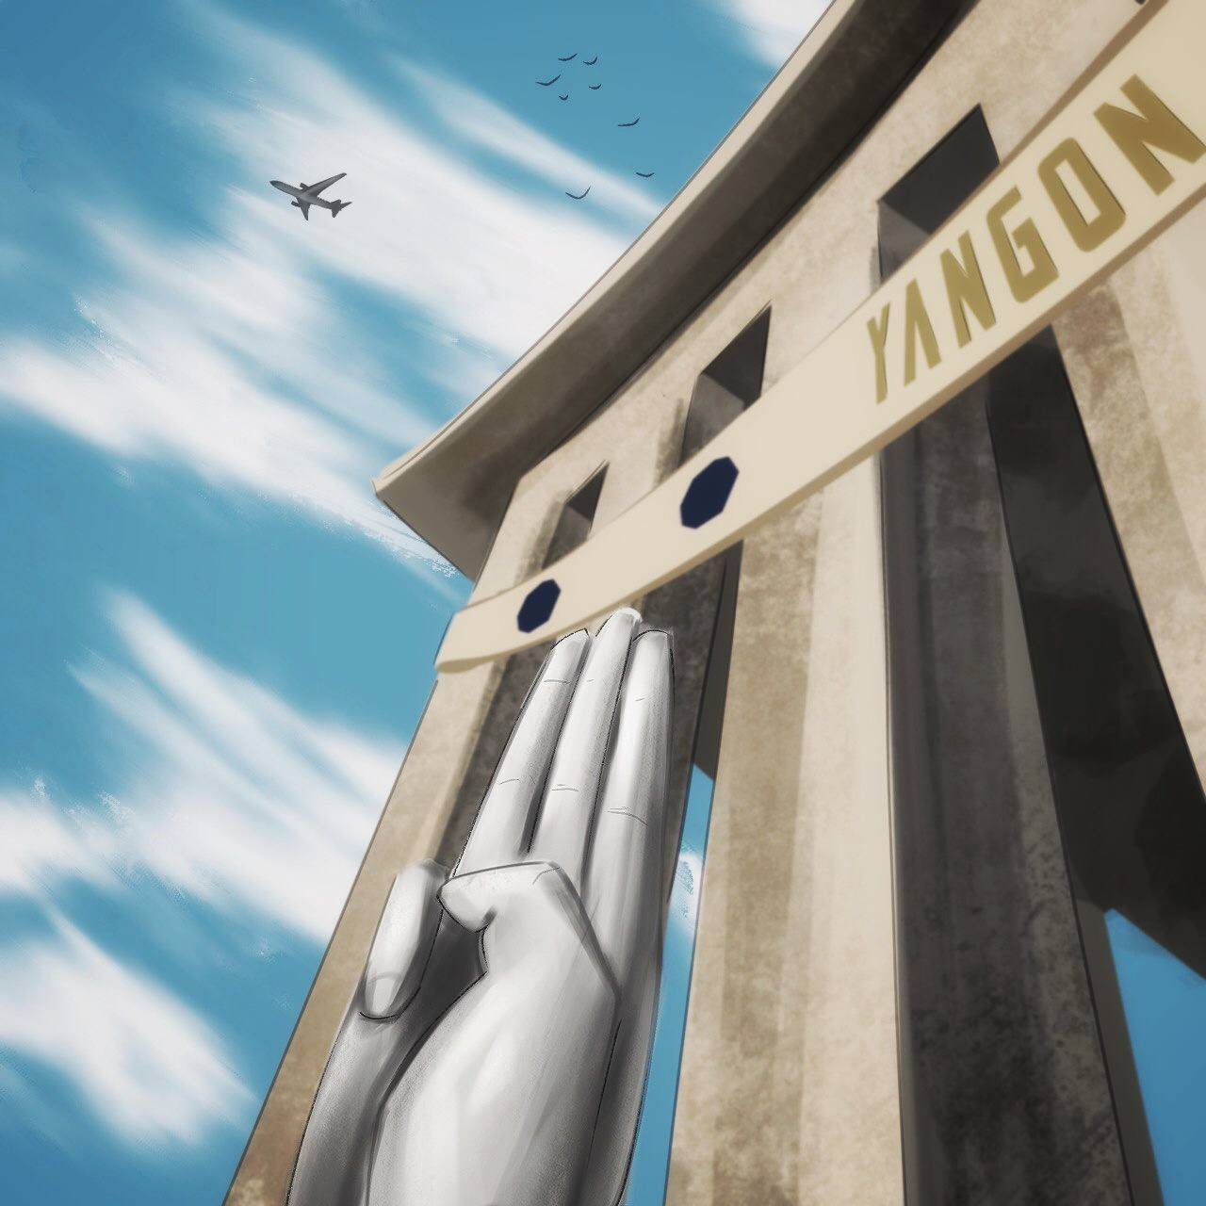
EVENTS OF REVOLUTION
CIVIL DISOBEDIENCE MOVEMENT IN
SPRING REVOLUTION 2021

Slide 14
Importance of the Past
History
Revolution Events
Memorial of Places
Intangible Features
Tangible Aspects

Slide 15
YTU
as a
Political HERITAGE
With Tangible and Intangible Aspects

Slide 16
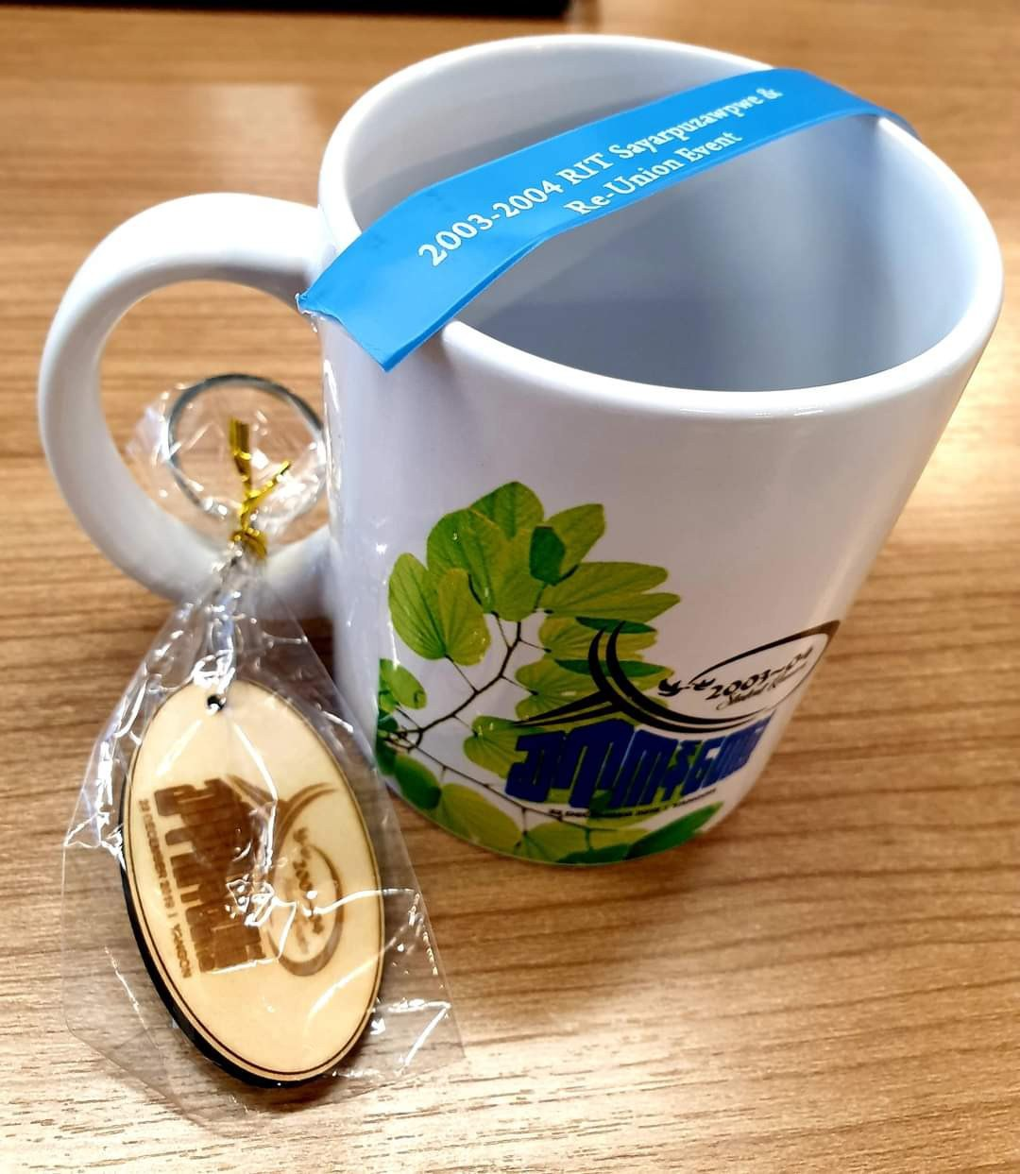
THANK YOU!

